Slide 1
HSA Hardware Specification hUMA and hQ
TA: Jiun-Hung Ding
Instructor: Yeh-Ching Chung
SSLAB

Slide 2
Traditional system with CPU and GPU
CPU
1
CPU
2
CPU
3
…
CPU
N
GPU
PCI-e
CPU memory(UMA)
GPU memory
For heavy compute bound process
Slow transition speed through PCI-e bus
Need advance programming skill

Slide 3
APU
CPU
1
CPU
2
CPU
3
CPU
N
BUS
…
GPU
CPU memory(UMA)
GPU memory
First time CPU and GPU in the same die.
The same physical memory address, but can’t be programmed.
More high transition speed, make GPU to execute more instruction.

Slide 4
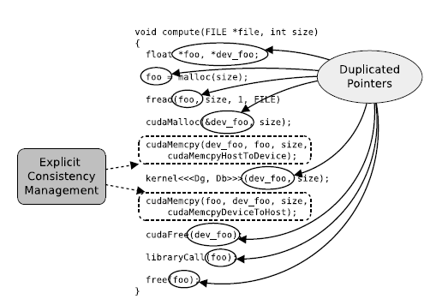
Heterogeneous Programming Issues
CUDA example

Slide 5
HSA
CPU
1
CPU
2
CPU
3
…
CPU
N
HCU
1
HCU
2
HCU
3
…
HCU
m
Heterogeneous Uniform Memory Access
UMA design can make all CUs access the same data.
Applications can choose favor CU.

Slide 6
Heterogeneous Uniform Memory Access
Heterogeneous Uniform Memory Access:
Appear in AMD promotional material in April 2013.
APU memory architecture.
Refer to CPU and GPU sharing the same system memory.
Cache coherent views.

Slide 7
Proposed Solution from HSA
To build a more easy programming environment
Don’t need programmer to pay attention to the data movement
Support shared address space between HSA components

Slide 8
hUMA

Slide 9
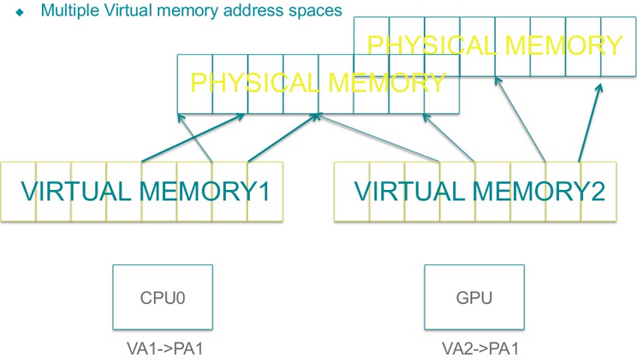
Shared Virtual Memory
Today:

Slide 10
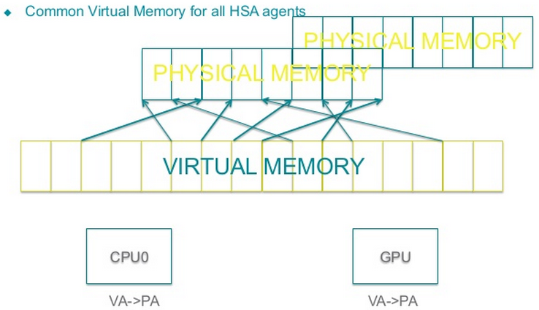
Shared Virtual Memory
HSA:

Slide 11
Shared Virtual Memory
Advantages:
  No mapping tricks, no copying back-and-forth between different PA addresses
  Send pointers (not data) back and forth between HSA agents.
Implications:
  Common page tables (and common interpretation of architectural semantics such as sharability, protection, etc.)
  Common mechanisms for address translation(and serving address translation faults)
  Concept of a process address space(PASID) to allow multiple, per process virtual address spaces within the system.

Slide 12
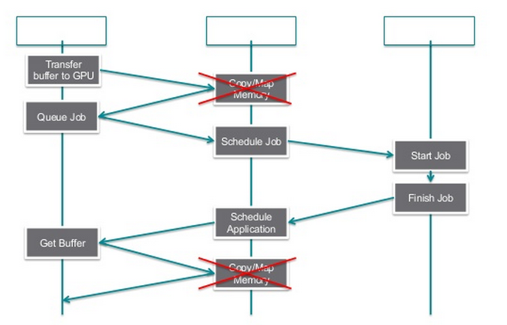
Shared Virtual Memory

Slide 13
Shared Virtual Memory
Allow HSA agent
(not limited to HSA components and host compute unit)
using common virtual address to access shared virtual address.
Support minimum virtual address width
→ 48bits for 64-bit HSA system.
→ 32bits for 32-bit HSA system.

Slide 14
Shared Virtual Memory
Workitem or WorkGroup memory:
  reserve virtual address ranges through system software.
  must be discoverable or configurable by system software.
  access within this ranges may be directed to non-shared memory.

Slide 15
Shared Virtual Memory(cont.)
  System can`t allocate pages for accessing in this non-shareable regions.
  Using shadowed page table is permitted.
  The shadowed page table provide host system page table attributes are visible to HSA agent and updates are synchronized transparently by system.
  Common set of system managed page tables should handle virtual address translation requests from all HSA agents.

Slide 16
Shared Virtual Memory(cont.)
Translation service shall:
  Interpret page table attributes consistently, guarantee memory protection mechanisms, in particular:
    Same page size
    Read/write permission
    Execute restrictions apply only to host compute units

Slide 17
Shared Virtual Memory(cont.)
    Support shared virtual memory for lowest privilege level.
    (higher privilege levels may be used by host operating system or hypervisor)
    HSA agent access to shared virtual memory must use only the lowest privilege level.
    Guarantee flags to track read/write access from HSA agent.

Slide 18
Shared Virtual Memory(cont.)
    Need the same interpretation of cacheability and data coherency properties for main memory type.
    Same interpretation of speculation permission properties.
    Interpret all memory type in common way and same way as host compute unit, with following caveats:
      There is no requirement of same interpretation of end-point ordering properties, observation ordering properties and multi-copy atomicity properties.
      Any memory type other than main memory type can either fit above caveats or generate a memory fault.

Slide 19
Shared Virtual Memory(cont.)
    Interpret other memory type can either follow the above condition or generate a memory fault on use of that memory type.

Slide 20
Shared Virtual Memory(cont.)
  Provide mechanism to notify system software translation fault. Notification shall include virtual address and a device tag to identify HSA agent issued the translation request.
  Provide mechanism to handle a recoverable translation fault. System should initiate to retry a fault address translation request.

Slide 21
Shared Virtual Memory(cont.)
  Provide Process Address Space ID(PASID) concept to service separate, per-process virtual address space within the system.
  If system support hardware virtualization, PASID shall allow a separation of PASID bits(PartitionID) and PASID bits for HSA MMU.
  The number of PASID bits for HSA MMU functionality shall at least 8.

Slide 22
Shared Virtual Memory(cont.)
  Support TLBs that cache issued virtual address translation. Must invalid repeated translate request.
  The invalid shall be forward by address translation service to any client device and shall perform a per-process level and allow a global invalidation of all TLBs.

Slide 23
Read-Only image data
Read-Only image data is required to remain static during execution of an HSA kernel.
This means it is not allowed to modify the data using a read/write view, or direct access to the data array either the same kernel, the host CPU or another kernel running in parallel.

Slide 24
Cache Coherence Domain
HSA agent access to global memory shall be coherent without need for explicit maintenance.
This only applies to global memory location with main memory type and doesn’t apply to read-only image access.
This specification doesn’t require that data memory access from HSA agent are coherent any memory location with any memory type other than primary memory type.

Slide 25
Cache Coherence Domain
This specification doesn’t require that instruction memory access to any memory type by HSA agents are coherent.
This specification doesn’t require that HSA agents have a coherent view of any memory location where HSA agents don’t specify the same memory attributes.
Coherency and ordering between HSA shared virtual memory aliased to the same physical address are not guaranteed.

Slide 26
Cache Coherence Domain
Advantage:
  Composability
  Reduced SW complexity when communicating between agents
  Lower barrier to entry when porting software
Implication:
  Hardware coherency support between all HSA agents

Slide 27
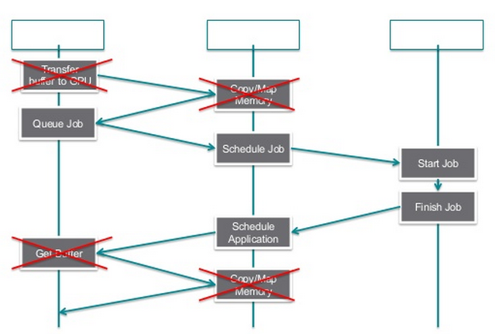
Cache Coherence Domain

Slide 28
Memory-Based Signaling and Synchronization
signal is an alternative, possibly more power-efficient, communication mechanism between two entities.
signal carries a value, which can be updated or conditionally waited via an API call or an HSAIL instruction.
There identifies HSA Agent as a participant in a HSA memory based signaling and synchronization.

Slide 29
Memory-Based Signaling and Synchronization
When multiple threads are attempting to signal without the use of atomics, no ordering guarantee is given by the HSA system.
The send signal API sets the signal handle with caller specified value.
signal handle would be given a copy of this new signal value after the wait condition is met(before timeout).

Slide 30
Memory-Based Signaling and Synchronization
The signal infrastructure allows for multiple waiters on a single signal.
In addition to the update of signals using Send, the API for send signal must support other atomic operations as well. For example AND, OR, XOR…etc.

Slide 31
Memory-Based Signaling and Synchronization
there are three types of synchronization defined in the systems architecture requirements:
  Acquire synchronization
    No memory operation listed after the acquire can be executed before the acquire-synchronized operation.
  Release synchronization
    No memory operation listed before the acquire can be executed after the release-synchronized operation.
  Acquire-Release synchronization
    This acts like a fence.
    No memory operation listed before the Acquire-Release synchronized operation can be move after it
    No memory operation listed after the Acquire-Release synchronized operation can be executed before it.

Slide 32
Memory-Based Signaling and Synchronization
Each operation on a signal value has the type of synchronization explicitly included in its name.
hsa_signal_send_acquire_release
hsa_signal_cas_release
hsa_signal_wait_acquire
hsa_signal_wait_acquire_release

Slide 33
Memory-Based Signaling and Synchronization
If HSA components and host compute unit don’t specify the same memory attributes, then HSA components don’t have coherent view of any memory location.
An HSA-compliant platform shall provide for the ability of HSA software to define and use signaling and synchronization primitives located in shared virtual memory accessible from host CPUs and HSA Agents in a non-discriminatory way.

Slide 34
Memory-Based Signaling and Synchronization
The signaling mechanism has following properties:
  Signal memory objects may contain additional implementation specific elements except signal data.
  Signal memory objects only manipulated by HASIL and HSA runtime.

Slide 35
Memory-Based Signaling and Synchronization
  The runtime include allocate, destroying and waiting.
  Signaling a signal object, including using atomic operations.
    signaling a signal object should wake up any HSA agent waiting on the signal that the condition is met for.
  Obtain current value of a signal object.

Slide 36
Memory-Based Signaling and Synchronization
  Waiting on a signaling memory object.
    Wait operation: equal, not equal, less than, greater than.
    Signal data is considered a signed integer for the purpose of the wait condition.
    No guarantee the condition is met when the wait operation returns.
    Applications/kernels must confirm the value.
    Wait operations have a duration before returning.

Slide 37
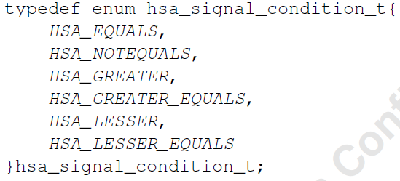
Memory-Based Signaling and Synchronization
Waiting operation:

Slide 38
Memory-Based Signaling and Synchronization
  Initializing a signaling memory object(setting the value without generating an event).
    This is an optimization – implementations can choose to implement the initialization operation to the send operation.
  Signal objects are allocated run-time. Both HSA runtime and HSAIL syscall can allocate signal objects.

Slide 39
Memory-Based Signaling and Synchronization
  A signal object should only be manipulated by HSA Agents within the process address space it was allocated in.
  Signals cannot be used for Inter-Process Communication (IPC).
  There should be no architectural limitation on the number of signal objects, unless implicitly limited by other requirements outlined in this document.

Slide 40
Memory-Based Signaling and Synchronization
  The signal object data size is aligned with the machine size .
  The set of atomic operations defined for general data in HSAIL should be supported for signal objects in HSAIL as well as in the HSA runtime.

Slide 41
Memory-Based Signaling and Synchronization
  The following memory ordering constraints are differentiated between HSA runtime and HSAIL:
    Send: rel, acq rel.
    Wait: acq, acq rel.
    Read: acq, acq rel.
    Atomic operations: none, rel, acq, acq rel.

Slide 42
Memory-Based Signaling and Synchronization
Advantage:
  Enables asynchronous interrupts between HSA agents, without involving the kernel
  Common idiom for work offload
  Low power waiting
Implication:
  Runtime support required
  Commonly implemented on the top of cache coherency flows

Slide 43
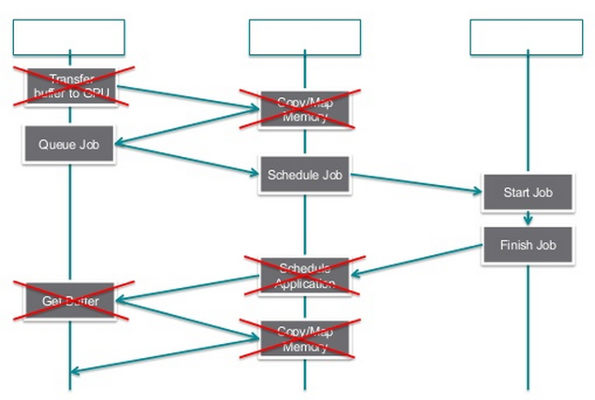
Memory-Based Signaling and Synchronization

Slide 44
Atomic memory operations
Must be supported atomic memory operations by HSA agents:
  Load from memory.
  Store to memory.
  Fetch from memory and include basic logic operation.(and, or, xor…etc.)
  Fetch from memory, apply integer arithmetic operation with one additional operand and store back.
  Exchange memory location with operand.
  Compare-and-swap.

Slide 45
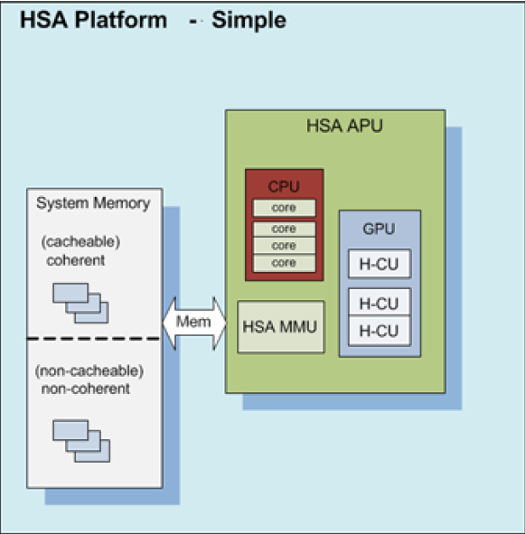
HSA Platform Topology Discovery

Slide 46
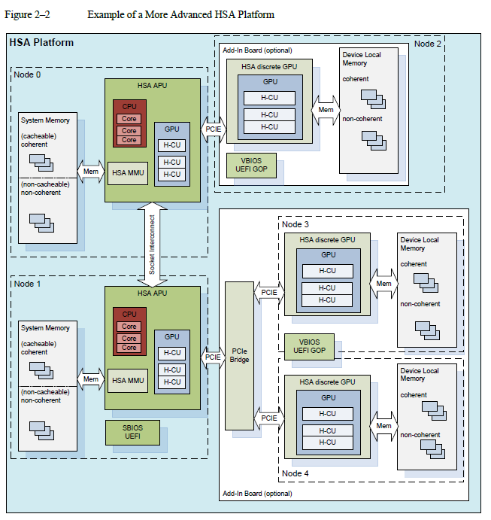
HSA Platform Topology Discovery

Slide 47
HSA Platform Topology Discovery
An HSA Memory Node (HMN) delineates a set of system components with “local” access to a set of memory resources .
HSA platform discovery strictly follows a memory locality paradigm.
Each of HMNs shall describe memory and memory controller capabilities, host compute unit capabilities and HSA component capabilities.

Slide 48
HSA Platform Topology Discovery
Node interconnect properties like bandwidth and latency can characterized as necessary.
Application can query system software and retrieve relevant topology information for each node.
The discovery API may be provide by the operation system.

Slide 49
A good memory model
Programmability; should make it easy to write multiwork-item programs. The model should be intuitive to most users.
Performance; should facilitate high-performance implementations at reasonable power, cost, etc.
Portability; would be adopted widely or at least provide backward compatibility or the ability to translate among models.

Slide 50
HSA memory model
Workitems can operate in one or more workgroups, with shared access to a set of memory regions.
A thread is a program-ordered sequence of operations through a processing element.
Some devices doesn’t subscribe to HSA memory model, but can move data in and out of HSA memory region.
HSAIL might interact with code in a stronger memory mode but is not visible to HSAIL-compliant memory system.

Slide 51
HSA memory model
The HSA memory model describes how multiple work-items interact with themselves and with HSA Agents.
Work-items can operate in one or more work-groups, with shared access to a set of memory regions.
A thread is a program-ordered sequence of operations through a processing element.

Slide 52
HSA memory model
A thread can be any HSA Agent, a work-item, or any method of sending operations through a processing element in an HSA-compatible device.
There might be devices in a system that do not subscribe to the HSA memory model, but can move data in and out of HSA memory regions.
These need coarse-grain synchronization.

Slide 53
HSA Memory Model Defined
The HSA memory model is defined in terms of work-items, visibility, and causality ordering rules.
For primitives of type “store,” visibility is when a store's data is available to loads from any work-item.
For primitives of type “load,” visibility is when a load gets the data that the work-item will put in the register.

Slide 54
Workitem ordering
Workitem address dependence order is maintained using virtual address only.
Two accesses to the same physical address using different virtual addresses are not guaranteed to be ordered.

Slide 55
Write serialization
There is a single order of all stores per virtual memory location, by any workitem.
If a single workitem stores repeatedly into the same address, no other workitem can see the stores in different order.
Allow to delay stores until kernel finishes.
Guarantees a kernel that just initialized a block of memory does not need explicit synchronization.

Slide 56
hQ

Slide 57
Introduction and Characteristic
HSA-compliant platform supports for the allocation of multiple “user-level command queues”
A user-level command queue shall be characterized as follows
  application-allocated
  user-level accessible virtual memory
  containing packets defined in the Architected Queueing Language
  AQL we will introduce it in late topic

Slide 58
Introduction and Characteristic
HSA software should receive memory-based structures to configure the hardware queues
  allow for efficient software management of the hardware queues of the HSA Component
This queue memory shall be processed by the HSA Component as a ring buffer
with separate memory locations defining write and read state information of that queue

Slide 59
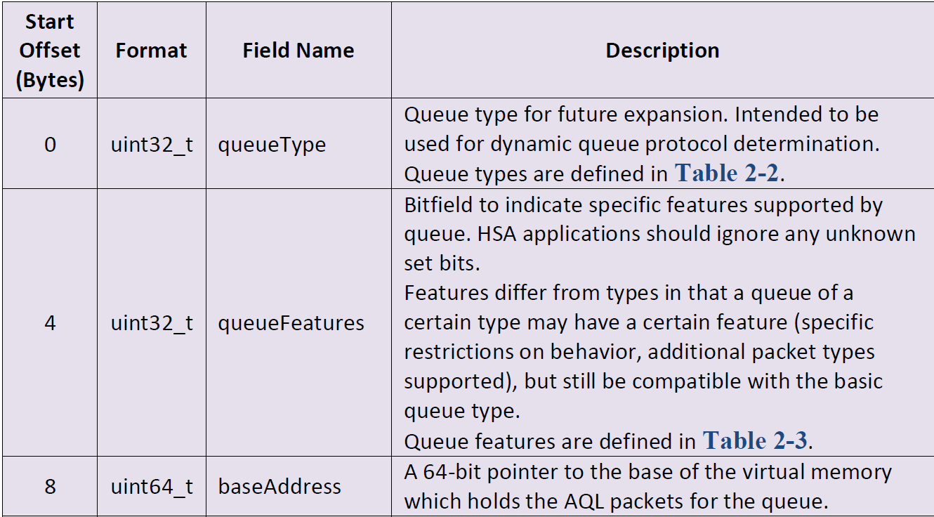
User Mode Queue structure

Slide 60
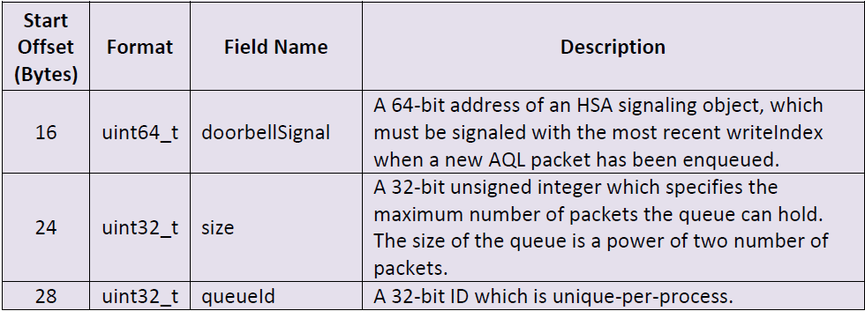
User Mode Queue structure

Slide 61
Queue head and tail
The queue also defines two properties that define the location of the “head” and “tail” of the queue
Head is the writeIndex – A 64-bit unsigned integer
Tail is the readIndex – A 64-bit unsigned integer

Slide 62
writeIndex
writeIndex – A 64-bit unsigned integer
Specifies the packetID of the next AQL packet slot to be allocated by the application or user-level runtime.
baseAddress + ((writeIndex % size) * AQL packet size) is the virtual address for the next AQL packet allocated.
Initialized to 0 at queue creation time.

Slide 63
readIndex
readIndex – A 64-bit unsigned integer which specifies the packetID of the next AQL packet to be consumed by the compute unit hardware.
baseAddress + ((readIndex % size) * AQL packet size) is the virtual address of the eldest AQL packet that is not yet released by the HSA Packet Processor.
Initialized to 0 at queue creation time.

Slide 64
writeIndex and readIndex
The writeIndex and readIndex properties cannot be accessed directly using memory operations from HSA applications or HSAIL kernels
Instead they are accessed through the HSA runtime API (HSA applications) or specific HSAIL instructions

Slide 65
writeIndex and readIndex
The writeIndex increases as new AQL packets are added to the queue
  AQL packets was added by the HSA agent
  wraps back to 0 when it exceeds the size of the queue
The readIndex increases as AQL packets are consumed
  AQL packets was consumed by the HSA component
  wraps back to 0 when it exceeds the size of the queue

Slide 66
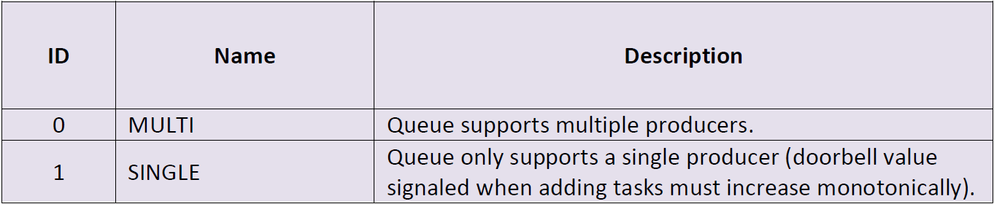
Queue type
MULTI means the queue have more than one AQL packet producers. So we have to take care of writeIndex and readIndex value.

Slide 67
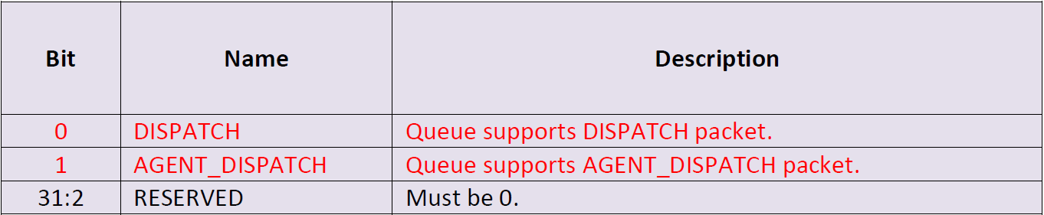
Queue Features
DISPATCH and AGENT_DISPATCH will be introduced in AQL topic

Slide 68
Queue mechanics
HSA specifies the following rules for how the queue must be implemented using the information defined above
The rules define a contract between the submitting HSA Agent and the HSA Packet Processor which enables the submitting HSA Agent to enqueue work for the associated HSA Agents in a manner that is portable across HSA implementations

Slide 69
Queue mechanics
The use of this signaling mechanism in the user mode queue implementation implies the same restriction on the user mode queues
Only HSA Agents within the queue process address space are allowed to submit AQL packets to a queue

Slide 70
Queue mechanics
The size of the queue is a power of two number of AQL packets.
The baseAddress must always be aligned to the AQL packet size.
The writeIndex increases as new AQL packets are added to the queue by the HSA Agent
The readIndex increases as AQL packets are processed and released by the HSA Packet Processor.

Slide 71
Queue mechanics
The writeIndex never wraps around, but the actual address offset used is ((writeIndex % size) * AQL packet size).
The readIndex never wraps around, but the actual address offset used is ((readIndex % size) * AQL packet size).
AQL packets are 64 bytes in size.
When the writeIndex == readIndex, the queue is empty.

Slide 72
Queue mechanics
An HSA Agent allocates an AQL packet slot by incrementing the writeIndex.
The value of the writeIndex before the increment operation is the packetID of the AQL packet allocated.
The format field of AQL packet slots is initialized to INVALID by the HSA system when a queue is created and when a packet has been processed.

Slide 73
Queue mechanics
A submitting HSA Agent may only modify an allocated AQL packet when packetID < readIndex + size and the AQL packet format field is set to INVALID. (size?? What size??)
HSA Packet Processor
  HSA Packet Processors are tightly bound to one or more HSA Agents, and provide the user mode queue functionality for the HSA Agents. HSA Packet Processors participate in the HSA memory model and are HSA Agents.

Slide 74
Queue mechanics
AQL packets are submitted to the HSA Packet Processor by changing the AQL packet format field from INVALID, and signaling the queue doorbell.
The HSA Agent must ensure the following constraints are respected:
  The HSA Agent is required to ensure that the rest of the AQL packet is globally visible before or at the same time as the format field is written.
  When the queue doorbell is signaled the HSA Agent is required to ensure that the AQL packet referenced by the doorbell value is already globally visible.

Slide 75
Queue mechanics
When an HSA Agent submits an AQL packet to the HSA Packet Processor the ownership of the AQL packet is transferred.
The HSA Packet Processor may update the AQL packet at any time after packet submission, and the submitting HSA Agent should not rely on the content of the AQL packet after submission.
HSA Packet Processors must not process an AQL packet with the format field set to INVALID.

Slide 76
Queue mechanics
HSA Packet Processors are not required to process an AQL packet until the doorbell is signaled with a packetID equal to the packetID of the packet or to a subsequent packetID.
It is not allowed to signal the doorbell with the packetID for an invalid packet.
The submitting HSA Agent must ensure the doorbell is signaled with a value meeting these conditions in order to make the dispatch visible to the HSA Packet Processor.

Slide 77
Queue mechanics
On a small machine model platform the least significant 32 bits of the packetID is used for the doorbell value.
Note that if multiple packets are submitted then the doorbell only needs to be signaled once, with the value corresponding to the last packet submitted.
For queues with a queueType restricting them to single producer mechanics the value signaled on the doorbell must be monotonically increasing.

Slide 78
Queue mechanics
HSA Packet Processors may process AQL packets after the packet format field is updated, but before the doorbell is signaled. HSA Agents must not rely on the doorbell as a “gate” to hold off execution of an AQL packet.
AQL packets in a queue are dispatched in-order, but may complete in any order.
If the entry at the head of the queue is not ready, other entries in the same queue will not make forward progress.

Slide 79
Queue mechanics
An HSA Packet Processor may choose to release a packet slot (by incrementing readIndex and setting the format field to INVALID) at any time after a packet has been submitted, regardless of the state of the task specified by the packet.
HSA Agents should not rely on the readIndex value to imply any state of a particular task.

Slide 80
Queue mechanics
The Packet Processor must make sure the packet slot format field is set to INVALID and made globally visible before the readIndex is moved past the packet and it is made available for new task submission.
The User Mode queue base address and queue size of each User Mode queues may be confined by system software to system-dependent restrictions
  for example, queue size and base address aligned to system page size, and so forth

Slide 81
Queue mechanics
As long as the imposed hardware restrictions do not impede HSA software’s use to allocate multiple such User Mode queues per application process
And system software provides for APIs allowing to impose such limits on a particular operating system.
Queues are allocated by HSA applications through the HSA runtime.

Slide 82
Queue mechanics
HSA Packet Processors shall have visibility of all their associated User Mode queues of all concurrently running processes.
And shall provide process-relative memory isolation and support privilege limitations for the instructions in the user-level command queue.
  These instructions shall consistent with the application-level privileges as defined for the host CPU instruction set.
The HSA system handles switching among the list of available queues for an HSA Packet Processor

Slide 83
Multiple vs Single HSA Agents
An HSA application may incorporate multiple HSA Agents or multiple threads on an HSA Agent that submit jobs to the same AQL queue.
  In the common case this will be multiple host CPU threads, or multiple threads running on a HSA Component.
In order to support job submission from multiple HSA Agents, the update of the queue writeIndex must use read-modify-write atomic memory operations.

Slide 84
Avoid Deadlocks
There are several options of implementing multiple thread packet submission, each with different characteristics for avoiding deadlocks if/when a queue is full
And we will give two examples later

Slide 85
Example1
Check for queue full before incrementing the writeIndex,
And use an atomic CAS(Compare And Swap) operation for the writeIndex increment.
This allows aborting the packet slot allocation in all cases if the queue is full, but when multiple writers collide this requires retrying the packet slot allocation.

Slide 86
Example2
First atomic add the number of AQL packets to allocate to the writeIndex
Then check if the queue is full.
This can be more efficient when many threads submit AQL packets, but it may be more difficult to manage queue full conditions gracefully.

Slide 87
Single submitting HSA Agent
An HSA application may limit the job submission to one HSA Agent thread only ("Single submitting HSA Agent").
Allowing the HSA Agent and packet processor to leverage this property and streamline the job submission process for such a queue.

Slide 88
Single submitting HSA Agent
The submission process can be simplified for queues that are only submitted to by a single HSA Agent:
  The increment of the writeIndex value by the job-submitting HSA Agent can be done using an atomic store, as it is the only HSA Agent permitted to update the value.
  The submitting HSA Agent may use a private variable to hold a copy of the writeIndex value and can rely on no one else modifying the writeIndex to avoid reading the writeIndex.

Slide 89
Packet Processor
Packet Processor behavior can be optimized as long as it complies with the specification.
For example :
  Use the packet format field to determine whether a packet has been submitted rather than reading the writeIndex queue field.
  Speculatively read multiple packets from the queue.
  Not update the readIndex for every packet processed.

Slide 90
Packet Processor
The queue mechanics do not require packets to be submitted in order.
  except for queues restricted to single producer mechanics
However, the Packet Processor performance and dispatch latency can benefit from the doorbell being signaled in order.
For this reason it is recommended that the doorbell is always signaled in order from within a single thread
  this is a strict requirement for queues using single producer mechanics

Slide 91
Queue index access
The queue writeIndex and readIndex properties are accessed from HSA applications using HSA runtime API calls and from HSAIL kernels using specific instructions.
The operations provided through the HSA runtime API and specific HSAIL instructions for accessing the queue writeIndex and readIndex properties are equivalent.
All access operations for the queue indices are relaxed atomics with global visibility.

Slide 92
Index Access Operation
Load the queue writeIndex property. Returns the 64 bit writeIndex value and takes the following parameters:
  Pointer to the queue structure.
Store new value for the writeIndex property. No return value, takes the following parameters:
  Pointer to the queue structure.
  New 64 bit value to store in the writeIndex property

Slide 93
Index Access Operation
Compare-and-swap operation on the writeIndex property. The compare-and-swap operation updates the writeIndex property if the original value matches the comparison parameter. Returns the original value of the writeIndex property and takes the following parameters:
  Pointer to the queue structure.
  64 bit comparison value
  New 64 bit value to store in the writeIndex property if comparison value matches original value.

Slide 94
Index Access Operation
Add operation on the writeIndex property. Returns the original value of the writeIndex property and takes the following parameters:
  Pointer to the queue structure.
  64 bit increment value
Load the readIndex property. Returns the 64 bit readIndex value and takes the following parameters:
  Pointer to the queue structure.

Slide 95
Index Access
HSA Agents other than host CPUs or HSA Components may access the writeIndex and readIndex properties through implementation specific means.
All HSA Agents accessing the queue indices must do so using relaxed atomic transactions with global visibility.

Slide 96
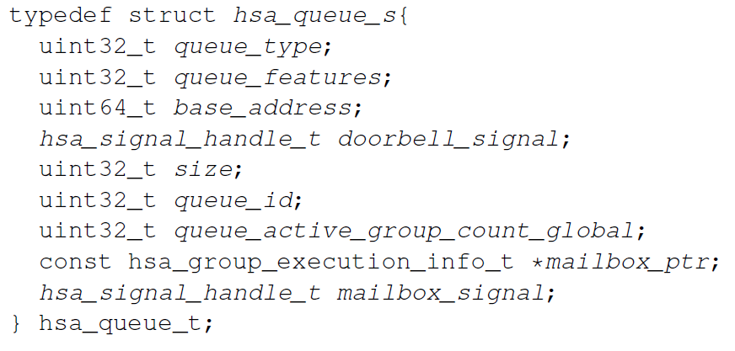
HSA_Queue_Structure
A queue in HSA is defined with the following structure:

Slide 97
HSA_Queue_Structure
queue type used for dynamic queue protocol determination
  0, the default queue type, is the only type supported
  queue features bitfield to indicate specific features supported by queue
base address A 64-bit pointer to the base of the virtual memory which holds the AQL packets for the queue

Slide 98
HSA_Queue_Structure
doorbell signal After writing a packet to the queue, user must signal this signal object with the most recent write offset
queue active group count global maximum number of concurrent workgroups that can run out of this queue
hsa group execution info t A pointer to the mailbox
mailbox signal the signal that user can wait on to get an indication that mailbox needs processing

Slide 99
HSA_Queue_Structure
the queue structure contains read index and write index. These are not exposed to the user directly
The user can access them via hsa queue get/cas/add write index and hsa queue get read index API

Slide 100
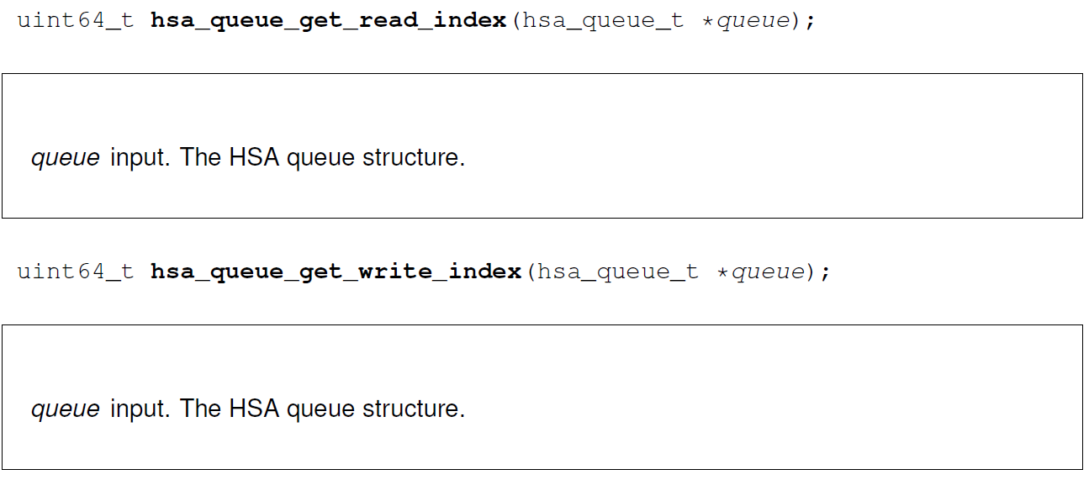
HSA_Queue_Get_Read/Write_Index

Slide 101
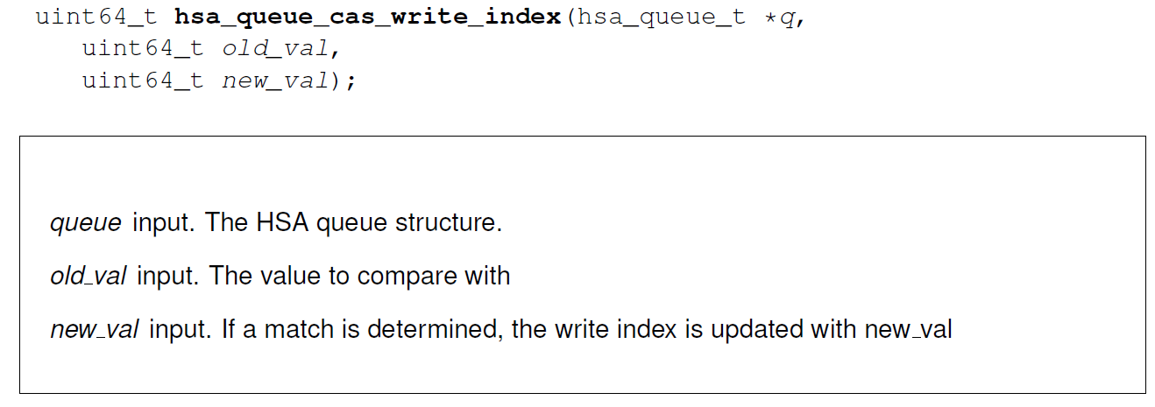
HSA_Queue_CAS_Write_Index
CAS means Compare And Swap

Slide 102
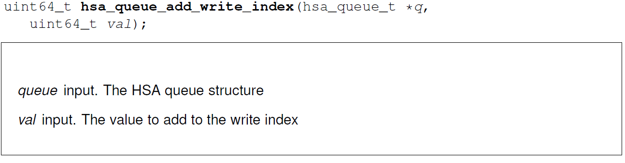
HSA_Queue_Add_Write_Index

Slide 103
Queue read index
The read index is automatically advanced when a packet is read by the HSA packet processor
The read index indicates the next AQL packet that will be consumed by the HSA packet processor
while the read index memory location is updated by the HSA Component and can be read by the agent
When the agent observes read index matches write index, at that instance, the queue can be considered empty

Slide 104
Queue write index
  The write index is a unique identifier for AQL packets in the queue
The write index memory is updated by the agents via. the runtime defined API
when the write index reaches its maximum value, an asynchronous error is generated by the packet processor and queue is put in error state

Slide 105
Doorbell signal
The doorbell signal is a signal from the agent writing the AQL packet to the HSA packet processor indicating that it has work to do
The value which the doorbell signal must be signaled with shall be the latest write index
The purpose of this signal is to inform the HSA packet processor that it has packets that need to be processed

Slide 106
Doorbell signal
However, packets may be processed by the HSA packet processor even before the doorbell signal has been signaled
When write index is advanced by the agent there are two scenarios that could arise
Scenario1: the HSA packet processor is in some low-powered state awaiting work and requires thedoorbell signal signal to wake it to continue reading packets.

Slide 107
Doorbell signal
Scenario 2: the HSA packet processor is already actively processing a packet and observers the write index be updated
  continues to process the new packets written – even before the agent has signaled the doorbell signal.
Despite the AQL packet for which the agent is signaling, the doorbell may already have been processed, the agent must ring the doorbell for every batch of AQL packets written.

Slide 108
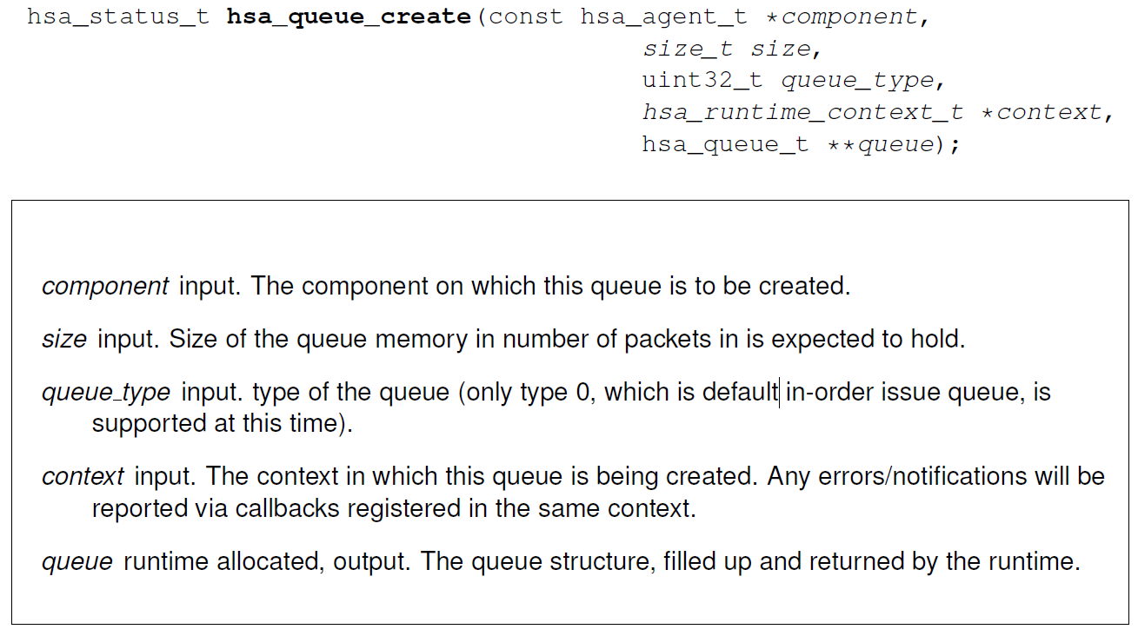
HSA_Queue_Creat

Slide 109
HSA_Queue_Creat
The hsa queue create API allocates the memory for the queue
The size is required to be aligned with a power of two number of AQL packets.
The pointer to the beginning of the memory allocated can be obtained in the field base address
No memory shall be allocated by an implementation if the queue creation fails

Slide 110
HSA_Queue_Creat
The hsa queue create API returns HSA_STATUS_SUCCESS when the queue is successfully created.
Otherwise, it can return one of the following status messages
  HSA_STATUS_ERROR_INVALID_ARGUMENT
  HSA_STATUS_ERROR_OUT_OF_RESOURCES
  HSA_STATUS_OTHER_BEGIN (see 2.1 for details).
    What is 2.1?? Need to be verify
The first ratified version does not define the queue type and queue feature – they have been marked as fields for future expansion

Slide 111
HSA_Queue_Creat
HSA STATUS ERROR INVALID ARGUMENT
  error code is returned when the queue size is not a power of two
HSA STATUS ERROR OUT OF RESOURCES
  if there is a failure in allocation of an internal structure required by the core runtime library.
  This error may also occur when the core runtime library needs to spawn threads or create internal OS-specific events.

Slide 112
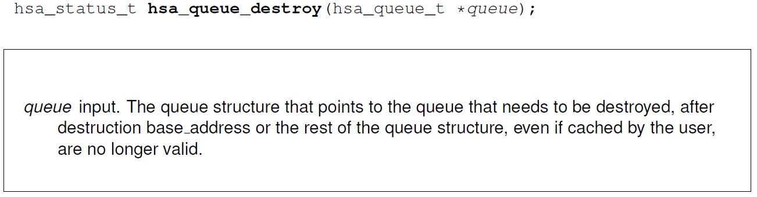
HSA_Queue_Destory

Slide 113
HSA_Queue_Destory
After queue destruction, it is considered undefined to access the memory pointed to be the base address
An implementation may choose to do internal memory management and reuse this memory for another queue

Slide 114
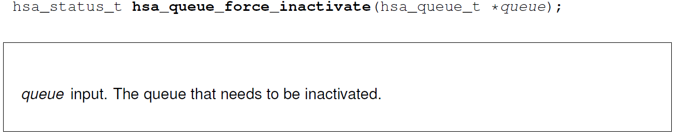
HSA_Queue_Force_Inactivate

Slide 115
HSA_Queue_Force_Inactivate
The queue can forcefully be inactivated by the user
This will kill any pending executions and prevent any new packets to be processed.
Any more packets written to the inactivated queue will be ignored by the packet processor

Slide 116
Queue Error Reporting
The HSA queue structure includes an error message queue, message queue handle
  User must initialize and pass as an argument at queue creation
Error message queue may either be created by the user using has_error_message_queue_create API or use the default error message queue generated by the has_initialize API.

Slide 117
Queue Error Reporting
There are two primary kinds of errors
1. Errors due to packet processing, such as invalid format, field-value, invalid signal, etc.
2. Errors occurring during subsequent resource/dispatch setup or system errors during dispatch

Slide 118
Queue State
A queue in HSA, once created, can be in one of the following states:
  active
  error pending inactive
  error inactive
  destroyed

Slide 119
Queue State - Active
Once a queue is successfully created, it enters an active state
Only in the active state, writing packets to the queue, updating the write index or ringing the doorbell has any effect

Slide 120
Queue State - Error pending inactive
When packet processing or dispatch setup encounters one of the errors described above the queue enters this state
the queue is not entirely inactive, but once the asynchronous activity concludes, it will become inactive
In error pending inactive state is not to be considered as destroyed, it still needs to be destroyed so the runtime can reclaim the memory allocated for this queue

Slide 121
Queue State - Inactive
If all the asynchronous activity concludes, the queue enters the inactive state
A queue can also enter this state when the user invokes the hsa_queue_force_inactivate API
In an inactive state, the queue structure and its packets may be inspected
  Only the packets that are between the read index and the write index are considered to be valid for inspection by the user.

Slide 122
Queue State - Inactive
The packet processor guarantees that all the packets that have been consumed by the packet processor will be signaled with either the completion information or an error
Invocation of has_queue_force_inactivate API when the queue already is in the inactive state has no effect.

Slide 123
Queue State - Destroyed
The queue has been destroyed by the user.
The resources allocated to the queue and the memory for the queue are no longer valid.
The queue structure is no longer valid.

Slide 124
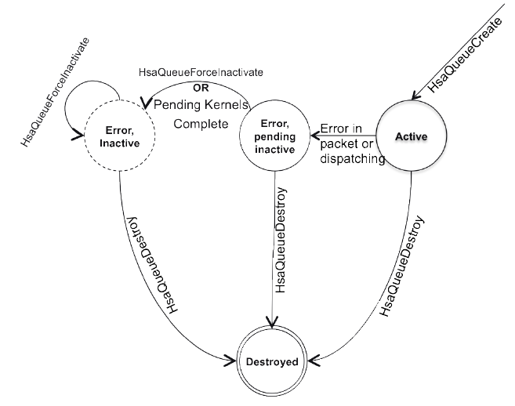
Queue State Diagram

Slide 125
Multi-Threaded Queue Access
HSA Core API does not provide explicit API for synchronized access to the queues
The architected queue data structure and read/write index update API are sufficient to allow users to implement thread-safe packet insertion

Slide 126
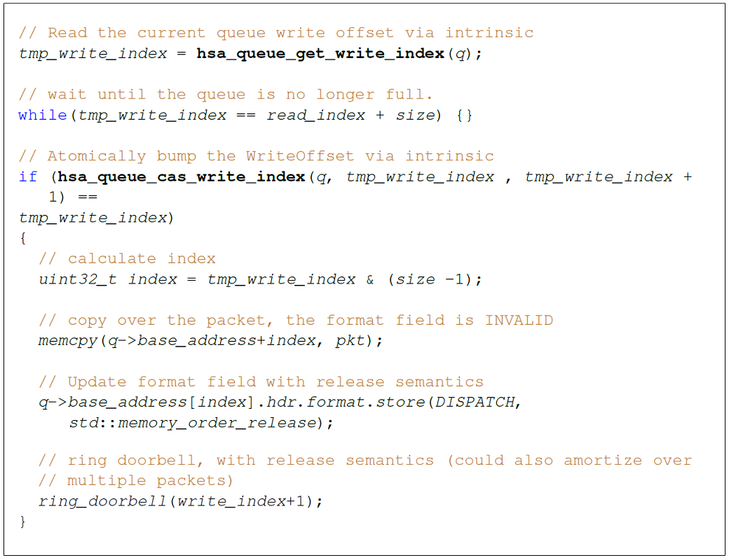
Multi-Threaded Queue Access

